Slide 1
CHAPTER 2
Basic Structure

Slide 2
CONTENTS
2.1 Sets
2.2 Set Operations
2.3 Functions.

Slide 3
2.1 Sets
2.1.1 Definitions and Notation
2.1.2 Cardinality
2.1.3 Power Set
2.1.4 Cartesian Products

Slide 4
2.1.1 Definitions and notation
Definition. A set is an unordered collection of elements.
Examples.
{1, 2, 3} is the set containing “1” and “2” and “3.”
{1, 1, 2, 3, 3} = {1, 2, 3} since repetition is irrelevant.
{1, 2, 3} = {3, 2, 1} since sets are unordered.
{1, 2, 3, …} is a way we denote an infinite set (in this case, the natural numbers).
∅ = {} is the empty set, or the set containing no element.
Note: ∅ ≠ {∅}

Slide 5
2.1.1 Definitions and notation
x ∈ S means “x is an element of set S.”
x ∉ S means “x is not an element of set S.”
A ⊆ B means “A is a subset of B.”
or, “B contains A.”
or, “every element of A is also in B.”
or, ∀x ((x ∈ A) → (x ∈ B)).
A
Venn Diagram
B

Slide 6
2.1.1 Definitions and notation
A ⊆ B means “A is a subset of B.”
A ⊇ B means “A is a superset of B.”
A = B if and only if A and B have exactly the same elements
iff, A ⊆ B and B ⊆ A
iff, A ⊆ B and A ⊇ B
iff, ∀x ((x ∈ A) ↔ (x ∈ B)).
So to show equality of sets A and B, show:
A ⊆ B
B ⊆ A

Slide 7
2.1.1 Definitions and notation
A ⊂ B means “A is a proper subset of B.”
A ⊆ B, and A ≠ B.
∀x ((x ∈ A) → (x ∈ B))
∧ ∃x ((x ∈ B) ∧ (x ∉ A))
A
B

Slide 8
2.1.1 Definitions and notation
Quick examples:
{1,2,3} ⊆ {1,2,3,4,5}
{1,2,3} ⊂ {1,2,3,4,5}
Is ∅ ⊆ {1,2,3}?
Yes! ∀x (x ∈ ∅) → (x ∈ {1,2,3}) holds,
because (x ∈ ∅) is false.
Is ∅ ∈ {1,2,3}?
No!
Is ∅ ⊆ {∅,1,2,3}?
Yes!
Is ∅ ∈ {∅,1,2,3}?
Yes!

Slide 9
2.1.1 Definitions and notation
Quiz time:
Is {x} ⊆ {x}?
Yes
Is {x} ∈ {x,{x}}?
Yes
Is {x} ⊆ {x,{x}}?
Yes
Is {x} ∈ {x}?
No

Slide 10
Ways to define sets
Explicitly: {John, Paul, George, Ringo}
Implicitly: {1,2,3,…}, or {2,3,5,7,11,13,17,…}
Set builder: { x : x is prime }, { x | x is odd }.

Slide 11
Ways to define sets
In general { x : P(x)}, where P(x) is some predicate
We read
“the set of all x such that P(x)”

Slide 12
Cardinality
If S is finite, then the cardinality of S, |S|, is the number of distinct elements in S.
If S = {1,2,3}
|S| = 3.
If S = {3,3,3,3,3}
|S| = 1.
If S = ∅
|S| = 0.
If S = { ∅, {∅}, {∅,{∅}} }
|S| = 3.
If S = {0,1,2,3,…}, |S| is infinite. (more on this later)

Slide 13
Power sets
If S is a set, then the power set of S is
P(S) = 2^{S} = { x : x ⊆ S }.
We say, “P(S) is the set of all subsets of S.”
If S = {a}
2^{S} = {∅, {a}}.
If S = {a,b}
2^{S} = {∅, {a}, {b}, {a,b}}.
If S = ∅
2^{S} = {∅}.
If S = {∅,{∅}}
2^{S} = {∅, {∅}, {{∅}}, {∅,{∅}}}.
Fact: if S is finite, |2^{S}| = 2^{|S|}. (if |S| = n, |2^{S}| = 2^{n})

Slide 14
Cartesian Product
The Cartesian Product of two sets A and B is:
A × B = { (a, b) : a ∈ A ∧ b ∈ B}
If A = {Charlie, Lucy, Linus}, and B = {Brown, VanPelt}, then
We’ll use these special sets soon!
A × B = {(Charlie, Brown), (Lucy, Brown), (Linus, Brown), (Charlie, VanPelt), (Lucy, VanPelt), (Linus, VanPelt)}
Note. (a,, b) = (c, d) iff a = c, and b = d
A,B finite → |A × B| = |A||B|

Slide 15
Cartesian Product
The Cartesian Product of n sets A₁, A₂, …, A_{n} is:
A₁ × A₂ × … × A_{n} =
= {(a₁, a₂,…, a_{n}): a₁ ∈ A₁, a₂ ∈ A₂, …, a_{n} ∈ A_{n}}
Note. (a₁, a₂, …, a_{n}) = (b₁, b₂,…, b_{n}) iff
a₁ = b₁, a₂ = b₂, …, a_{n} = b_{n}
We’ll use these special sets soon!

Slide 16
2.2.1 Set operation
The union of two sets A and B is:
A ∪ B = { x : x ∈ A ∨ x ∈ B}
If A = {Charlie, Lucy, Linus}, and B = {Lucy, Desi}, then
A ∪ B = {Charlie, Lucy, Linus, Desi}
B
A

Slide 17
The intersection of two sets A and B is:
A ∩ B = { x : x ∈ A ∧ x ∈ B}
If A = {Charlie, Lucy, Linus}, and B = {Lucy, Desi}, then
A ∩ B = {Lucy}
B
A

Slide 18
The intersection of two sets A and B is:
A ∩ B = { x : x ∈ A ∧ x ∈ B}
If A = {x : x is a US president}, and B = {x : x is in this room}, then
A ∩ B = {x : x is a US president in this room} = ∅
Sets whose intersection is empty are called disjoint sets
B
A

Slide 19
The complement of a set A is:
If A = {x : x is not shaded}, then
U
A
= U and
U = ∅

Slide 20
The symmetric difference, A ⊕ B, is:
A ⊕ B = { x : (x ∈ A ∧ x ∉ B) ∨ (x ∈ B ∧ x ∉ A)}
= (A – B) ∪ (B – A)
= { x : x ∈ A ⊕ x ∈ B}
U
A – B
B – A

Slide 21
2.2.2 Set Identities
Identity A ∩ U = A
A ∪ ∅ = A
U
A
Domination A ∪ U = U
A ∩ ∅ = ∅
Idempotent A ∪ A = A
A ∩ A = A

Slide 22
2.2.2 Set Identities
Excluded Middle
U
A
Uniqueness
Double complement

Slide 23
2.2.2 Set Identities
Commutativity A ∪ B = B ∪ A
A ∩ B = B ∩ A
Associativity (A ∪ B) ∪ C = A ∪ (B ∪ C)
(A ∩ B) ∩ C =A ∩ (B ∩ C)
Distributivity
A ∪ (B ∩ C) = (A ∪ B) ∩ (A ∪ C)
A ∩ (B ∪ C) = (A ∩ B) ∪ (A ∩ C)

Slide 25
2.2.2 Set Identities
DeMorgan’s I
DeMorgan’s II
A
B

Slide 26
4 Ways to prove identities
New & important
Show that A ⊆ B and that A ⊇ B.
Use a membership table.
Use previously proven identities.
Use logical equivalences to prove equivalent set definitions.
Like truth tables
Like ≡
Not hard, a little tedious

Slide 27
4 Ways to prove identities
Prove that
Not a particularly interesting example, sorry.

Slide 28
4 Ways to prove identities
Prove that
Haven’t we seen this before?
using a membership table.
0 : x is not in the specified set
1 : otherwise
A | B |  |  |  | A ∪ B
1 | 1 | 0 | 0 | 0 | 1 | 0
1 | 0 | 0 | 1 | 0 | 1 | 0
0 | 1 | 1 | 0 | 0 | 1 | 0
0 | 0 | 1 | 1 | 1 | 0 | 1

Slide 29
4 Ways to prove identities
Prove that
using logically equivalent set definitions
(A ∪ B) = {x : ¬(x ∈ A ∨ x ∈ B)}
= {x : ¬(x ∈ A) ∧ ¬(x ∈ B)}
= {x : (x ∈ A) ∧ (x ∈ B)}
= A ∩B

Slide 30
4 Ways to prove identities
Prove that
using known identities

Slide 31
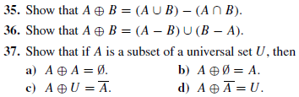

Slide 32
2.2.3 Generalized Set Operations
Generalized Union
Ex. Let U = N, and define:
A_{i}={i, i+1, i+2, …}
Then

Slide 33
Generalized Intersection
Ex. Let U = N, and define:
A_{i}={i, i+1, i+2, …}
Then

Slide 34
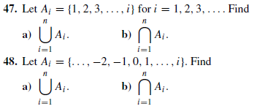
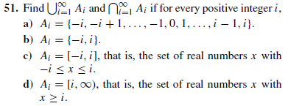

Slide 35
2.2.4 Computer Representation of Sets
Let U = {x₁, x₂,…, x_{n}}, and choose an arbitrary order of the elements of U, say
x₁, x₂,…, x_{n}
Let A ⊆ U. Then the bit string representation of A is the bit string of length n : a₁ a₂… a_{n} such that a_{i} =1 if x_{i} ∈ A, and 0 otherwise.
Ex. If U = {x₁, x₂,…, x₆}, and A = {x₁, x₃, x₅, x₆},
then the bit string representation of A is
(101011)

Slide 36
Sets as bit strings
Ex. If U = {x₁, x₂,…, x₆}, A = {x₁, x₃, x₅, x₆}, and B = {x₂, x₃, x₆}.
Then we have a quick way of finding the bit string corresponding to of A ∪ B and A ∩ B.
A | 1 | 0 | 1 | 0 | 1 | 1
B | 0 | 1 | 1 | 0 | 0 | 1
A
B
A ∪ B | 1 | 1 | 1 | 0 | 1 | 1
A ∩ B
 | 0 | 0 | 1 | 0 | 0 | 1
Bit-wise OR
Bit-wise AND

Slide 37
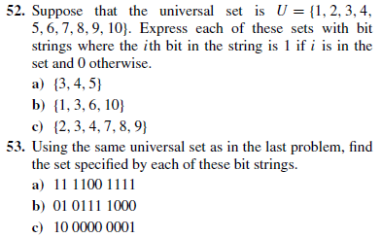

Slide 38
2.3 Functions
2.3.1 Introduction
2.3.2 One-to-One and Onto Functions.
2.3.3 Inverse Functions and Composition of Functions
2.3.4 The Graphs of Functions
2.3.5 Asymptotic Notation
2.3.6 Hash function

Slide 39
2.3.1 Introduction
Definition. A function f is a rule that assigns to each element x in a set A exactly one element y=f(x) in a set B
x
y=f(x)
a
b=f(a)
f
A
B
A is the domain, B is the codomain of f.

Slide 40
2.3.1 Introduction
x
y=f(x)
a
b=f(a)
f
A
B
b = f(a) is the image of a and a is the preimage of b.
The range of f is the set {f(a), a ∈ A}

Slide 41
Example.
A = {Michael, Tito, Janet, Cindy, Bobby}
B = {Katherine Scruse, Carol Brady, Mother Teresa}
Let f : A → B be defined as f(a) = mother(a).
Michael Tito Janet Cindy Bobby
Katherine Scruse
Carol Brady
Mother Teresa

Slide 42
For any set S ⊆ A, image(S) = {b : ∃a ∈ S, f(a) = b}= f(S)
So, image({Michael, Tito}) = {Katherine Scruse} image(A) = B – {Mother Teresa}
Michael Tito Janet Cindy Bobby
Katherine Scruse
Carol Brady
Mother Teresa
What about the range?
Some say it means codomain, others say, image.

Slide 43
Algebra of functions: let f and g be functions with domains A and B. Then the functions f+g, f –g , fg and f/g are defined as follows:
domain = A∩B
domain = A∩B
domain = A∩B
domain = {x∈A∩B /g(x)≠0}

Slide 44
Example: let f(x) = x², g(x) = x – x² be functions from R to R, find f + g and fg.
Solution: We have
(f + g)(x) = x² +(x –x²) = x
And
(fg)(x) = x² (x –x²) = x³ –x⁴

Slide 45
2.3.2 One-to-One and Onto Functions
Definition.A function f: A → B is one-to-one (injective, an injection) if
∀x,y (f(x) = f(y) → x = y)
Michael Tito Janet Cindy Bobby
Katherine Scruse
Carol Brady
Mother Teresa
Not one-to-one
Every b ∈ B has at most 1 preimage.

Slide 46
Remark. A function f: A → B is one-to-one iff
∀x,y (x ≠ y → f(x) ≠ f(y))
Recall that
A function f is strictly increasing on an interval I ⊆ R if
∀x,y (x < y → f(x) < f(y))
f is strictly decreasing on I if
∀x,y (x < y → f(x) > f(y))
It is clear that a strictly increasing or strictly decreasing function is one-to-one.

Slide 47
Onto Functions
Definition. A function f: A → B is onto (surjective, a surjection) if ∀b ∈ B, ∃a ∈ A f(a) = b
Every b ∈ B has at least 1 preimage.
Not onto
Michael Tito Janet Cindy Bobby
Katherine Scruse
Carol Brady
Mother Teresa

Slide 48
Onto Functions
Example. Is the function f(x) = x² from Z to Z onto?
Solution: The function f is not onto since there is no x in Z such that x² = –1
Example. Is the function f(x) = x + 1 from Z to Z onto?
Solution: The function f is onto since for every y in Z, there is an element x in Z such that x + 1 = y (by taking x = y –1)

Slide 49
Bijection
Definition. A function f: A → B is bijective if it is one-to-one and onto. We also say that f is a bijection
Every b ∈ B has exactly 1 preimage.
Isaak Bri Lynette Aidan Evan
Isaak Bri Lynette Aidan Evan
Cinda Dee Deb Katrina Dawn
Cinda Dee Deb Katrina Dawn

Slide 50
2.3.3 Inverse Functions and Compositions of Functions
Definition. Let f : A → B be a bijection. Then the inverse function of f , denoted by f ^{–1}
is the function that assigns each element b in B the unique element a in A such that f(a) = b. Thus f ^{–1}(b) = a.
Isaak Bri Lynette Aidan Evan
Cinda Dee Deb Katrina Dawn
f ^{–1}(Cinda) = Isaak, f ^{–1}(Dee) = Bri, …, f ^{–1}(Dawn) = Evan

Slide 51
Example. Is the function f(x) = x² from Z to Z invertible? (i.e. the inverse function exists)
Solution: The function f is not onto. Therefore it is not a bijection, and hence not invertible
Example. Is the function f(x) = x + 1 from Z to Z invertible?
Solution: The function f is a bijection so it is invertible.

Slide 52
Example. Is the function f(x) = x + 1 from Z to Z invertible? What is its inverse?
Solution: The function f is a bijection so it is invertible.
To find the inverse, let y be any element in Z, we find the element x in Z such that y = f(x) = x + 1.
Solving this equation we obtain x = y –1.
Hence f ^{–1}(y) = y –1.
We also write f ^{–1}(x) = x –1.

Slide 53
Definition. The composition of a function g: A → B and a function f : B → C is the function fog : A → C defined by
fog(x) = f(g(x))
Note. The domain of fog is also the domain of g, and the codomain of fog is also the codomain of f.
x (input)
g
g(x)
f
f(g(x)) (output)

Slide 54
Arrow diagram for f o g
f og
A
B
C
•x
g
f
• f(g(x))
• g(x)

Slide 55
Example. let f(x) = x² and g(x) = x – 3 are functions from R to R.
Find the compositions fog and gof
Solution.
(fog)(x) = f(g(x)) = f(x – 3) = (x –3)²
(gof)(x) = g(f(x)) = g(x²) = x² – 3
This shows that in general: fog ≠ gof

Slide 56
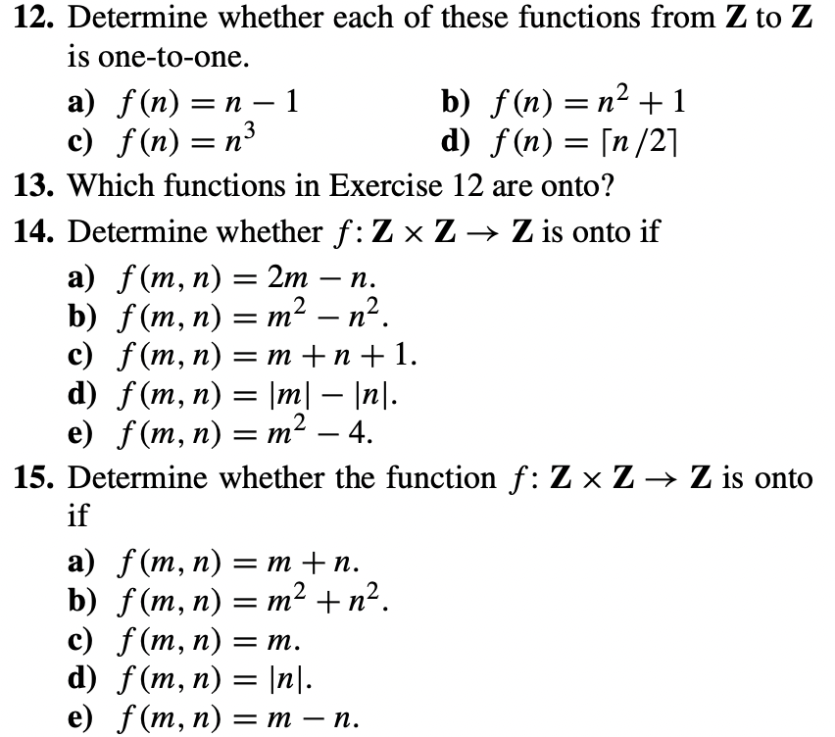

Slide 57
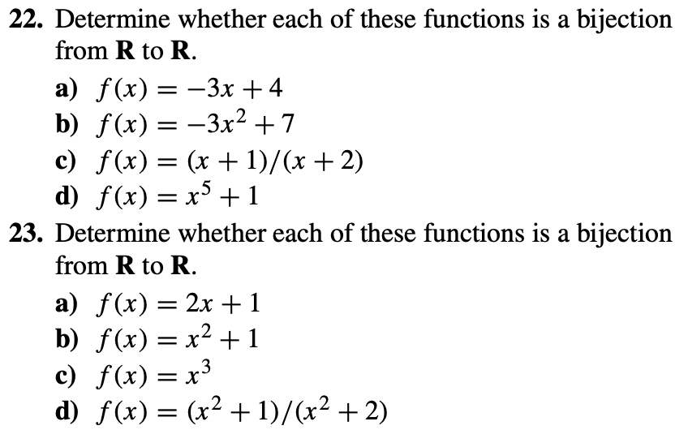

Slide 58
2.3.4 The Graph of a Function
Definition. Let f : A → B be a function. Then the graph of f , is the set of ordered pair (a, b) with a in A and f(a) = b.
Example. The graph of the function f : R → R such that f(x) = – x / 2 – 25

Slide 59
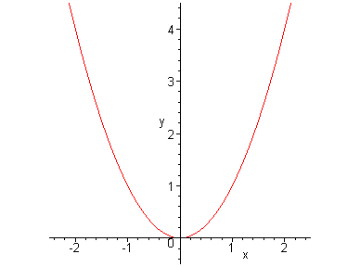
Example. The graph of the function f : R → R such that f(x)=x²

Slide 60
Example. The average CO₂ level in the atmosphere is a function of time given by the following table
Year | CO₂(in ppm)
1980 | 338.5
1982 | 341.0
1984 | 344.3
1986 | 347.0
1988 | 351.3
1990 | 354.0
1992 | 356.3
1994 | 358.9
1996 | 362.7
1998 | 366.7
The graph of this function

Slide 61
2.3.5 Some Important Functions
Ceiling.
f(x) = ⎡ x ⎤ the least integer y so that x ≤ y.
Ex: ⎡1.2⎤ = 2; ⎡-1.2⎤ = -1; ⎡1⎤ = 1
Floor.
f(x) = ⎣x⎦ the greatest integer y so that y ≤ x.
Ex: ⎣1.8⎦ = 1; ⎣-1.8⎦ = -2; ⎣-5⎦ = -5
Quiz: what is ⎡-1.2 + ⎣1.1⎦⎤ ?
0

Slide 62
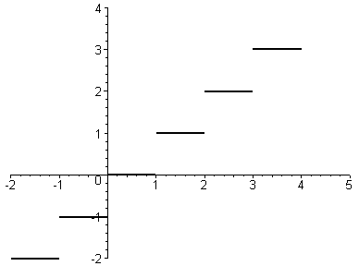
The graph of the floor function
The graph of the ceiling function

Slide 63
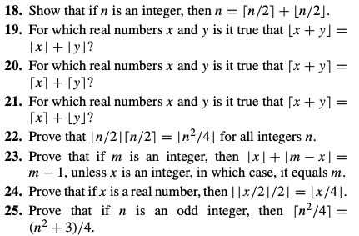

Slide 64
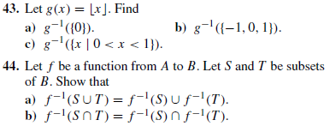

Slide 65
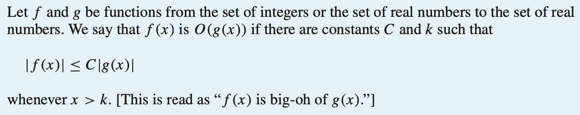
Big-O, Big-Omega, Big-Theta notation

Slide 66
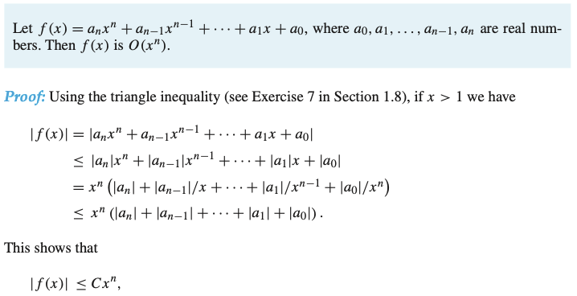

Slide 67
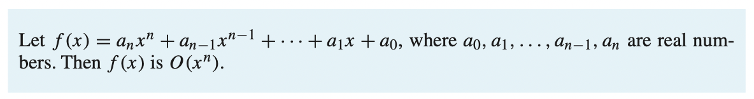

Slide 68
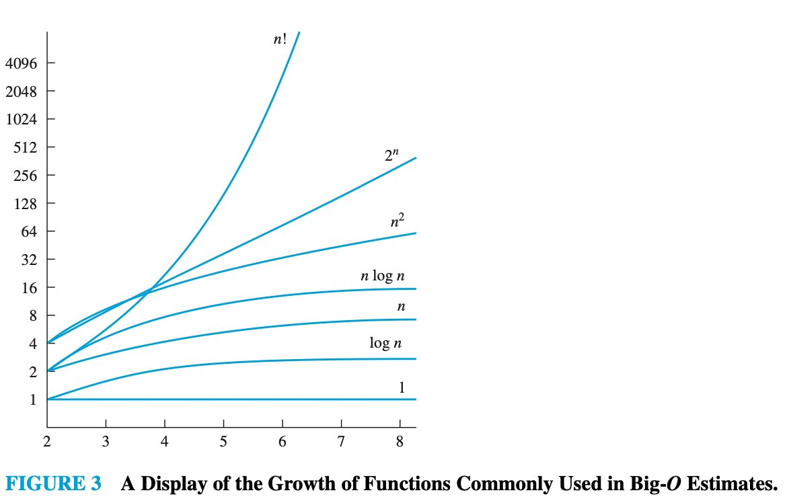

The functions used in these estimates often include the following:

Slide 69
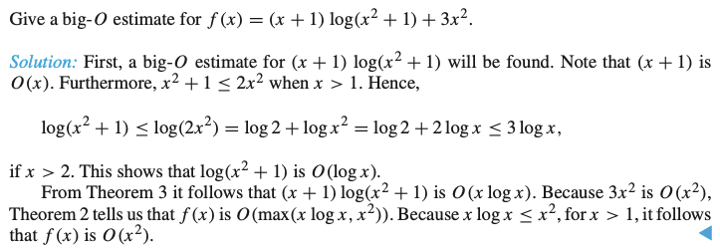

Slide 70
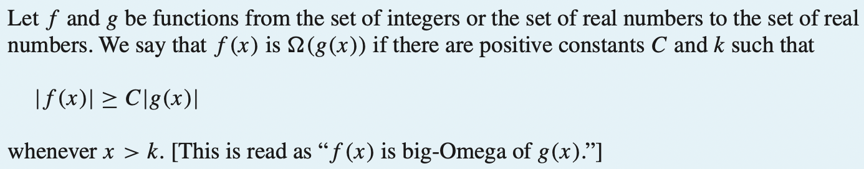
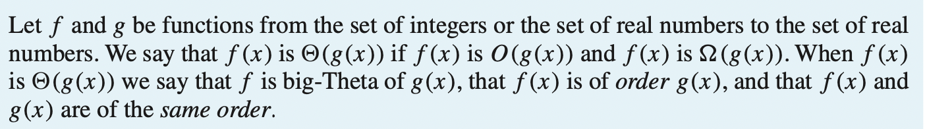

Slide 71
